Slide 1

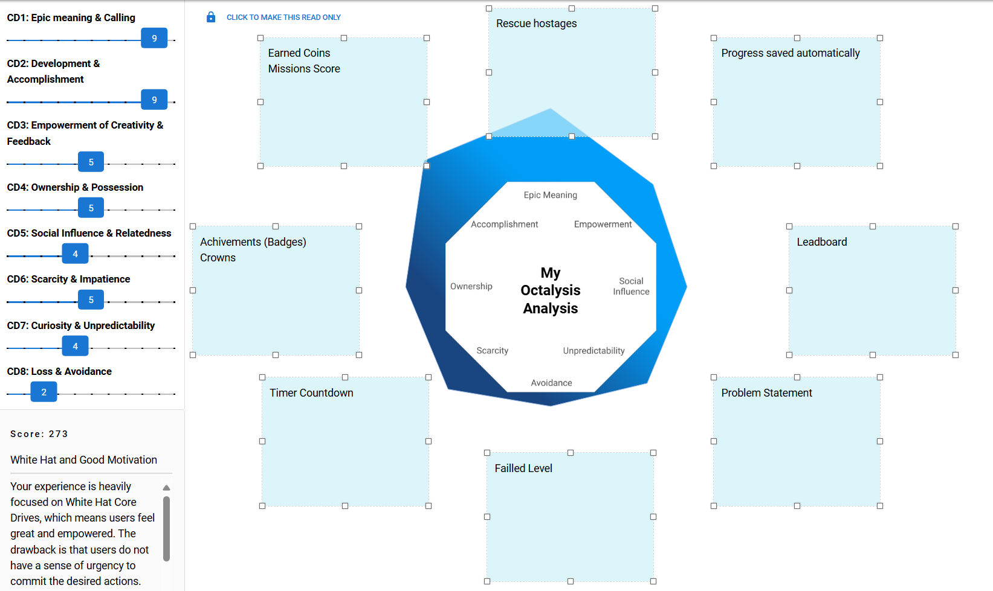
Underground Hero – Current State
Score: 273 Proud of You and Good Motivation
Your experience is fairly balanced in both White Hat and Black Hat Core Drives. I'm proud of you ;-) / Also, you seem to have a great balance between Left Brain and Right Brain Core Drives, which means you likely have a good balance between Intrinsic and Extrinsic Motivation. Just be very careful because Extrinsic Motivation designed badly may kill Intrinsic Motivation.

Slide 2
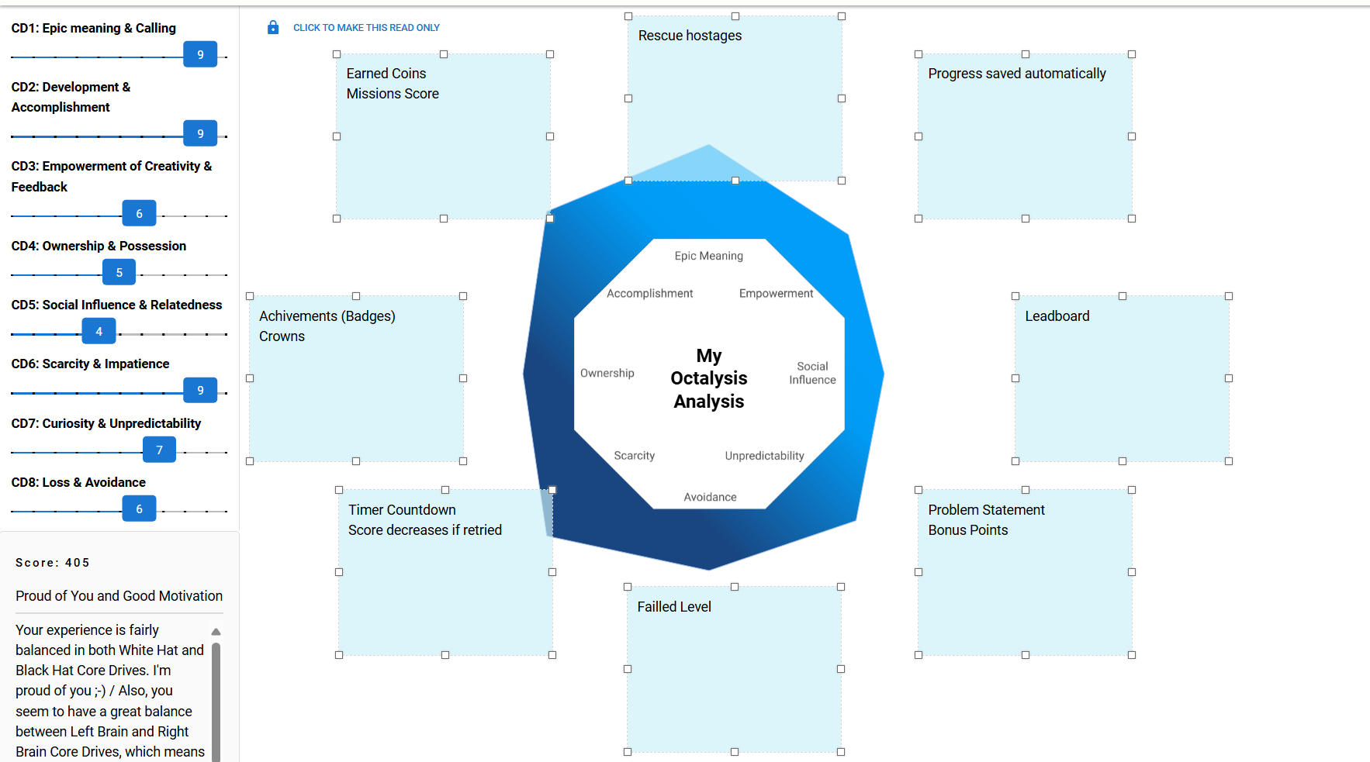
Underground Hero – Potential Improvements
Score: 405
Proud of You and Good Motivation
Your experience is fairly balanced in both White Hat and Black Hat Core Drives. I'm proud of you ;-) / Also, you seem to have a great balance between Left Brain and Right Brain Core Drives, which means you likely have a good balance between Intrinsic and Extrinsic Motivation. Just be very careful because Extrinsic Motivation designed badly may kill Intrinsic Motivation.

